Slide 1
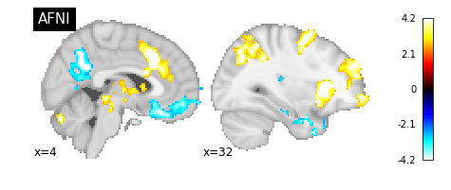
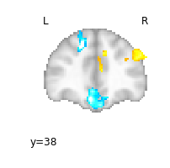
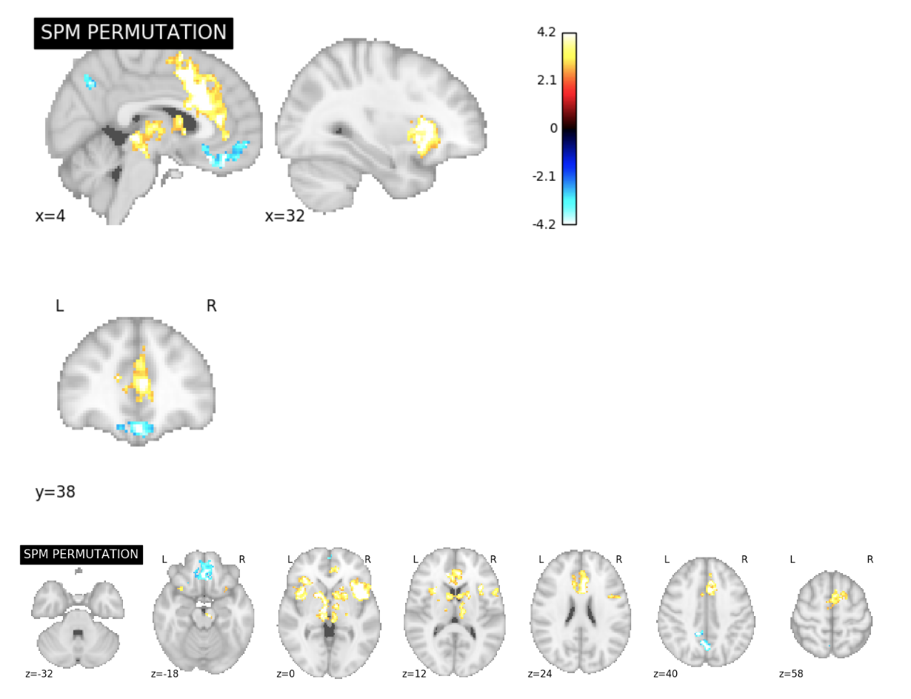
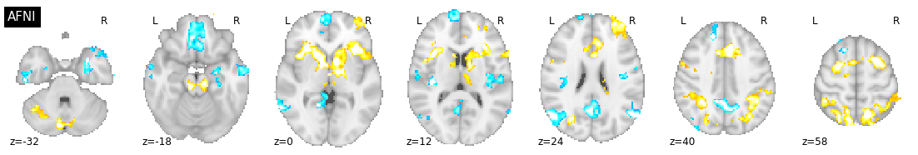
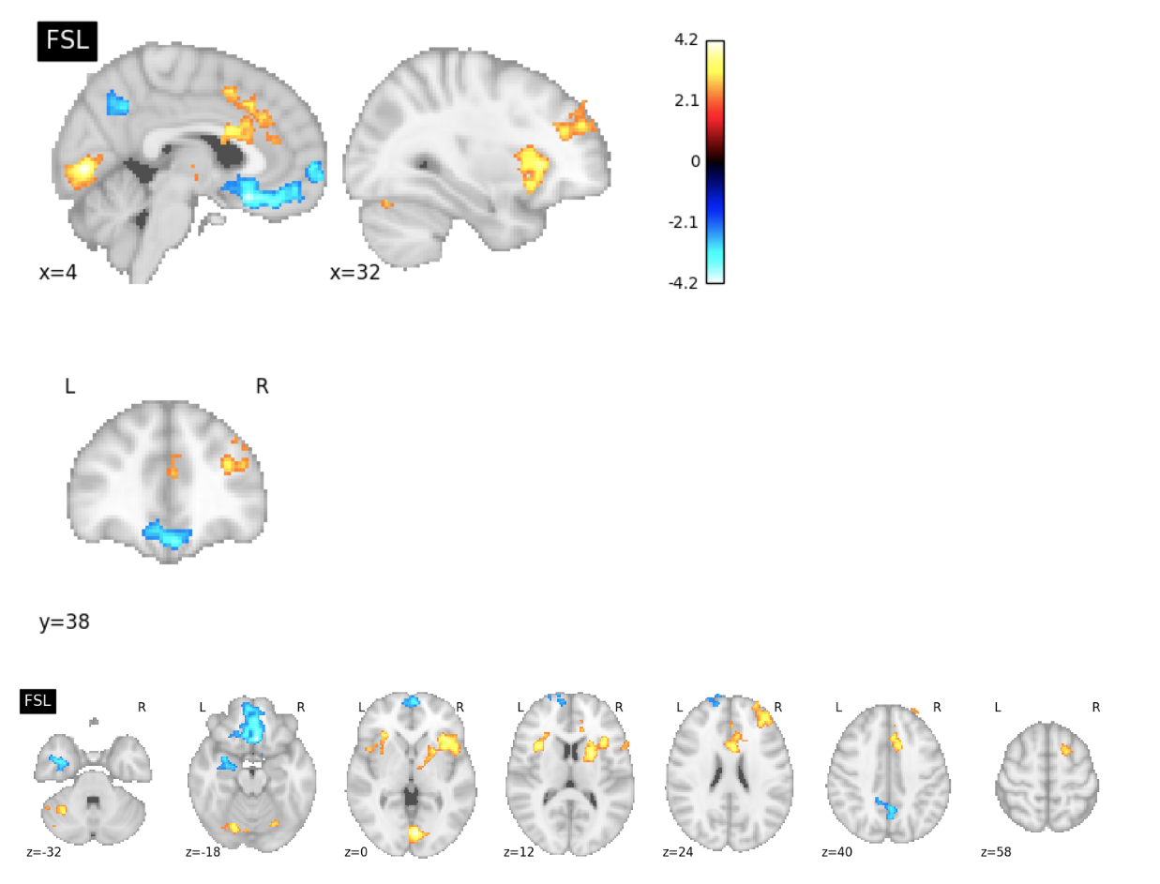
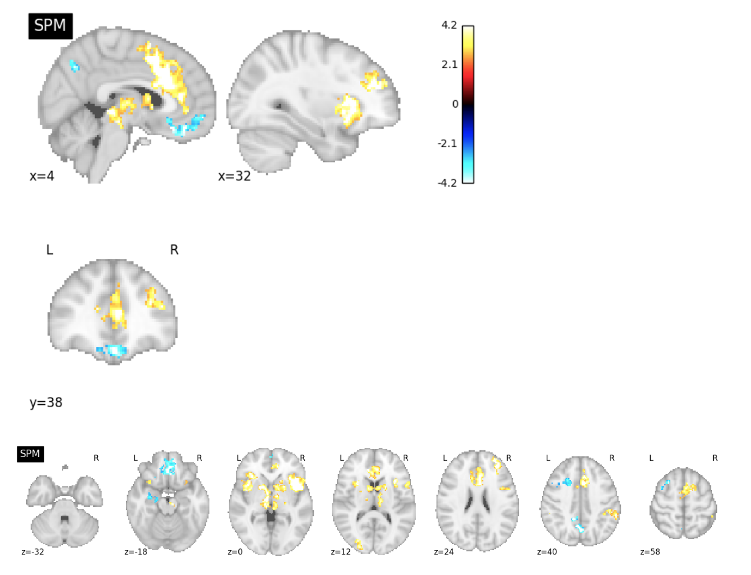
Software Comparison Figures
ds000001 Reproduction Excursion Set Map Slice Comparisons

Slide 2
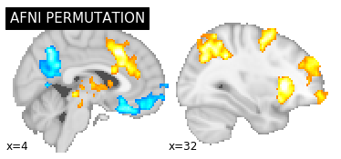
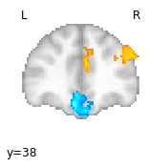
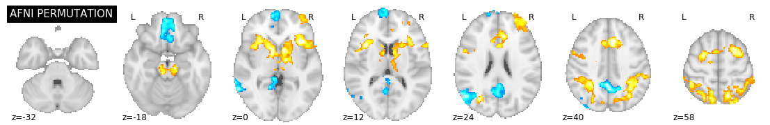
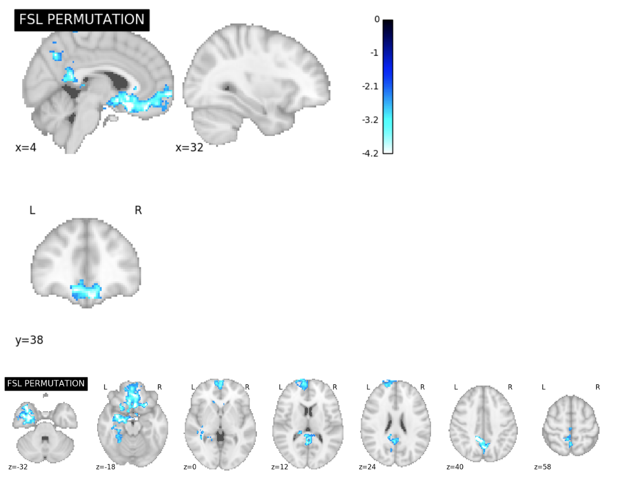
ds000001 Permutation Test Excursion Set Map Slice Comparisons

Slide 3
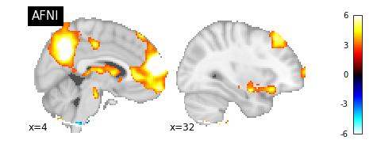
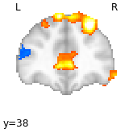
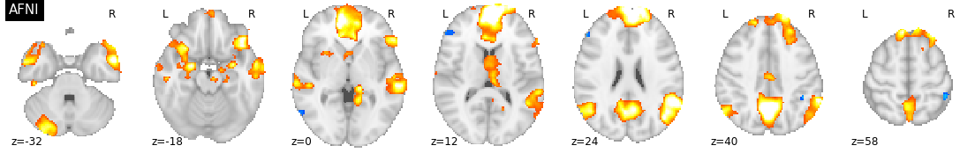
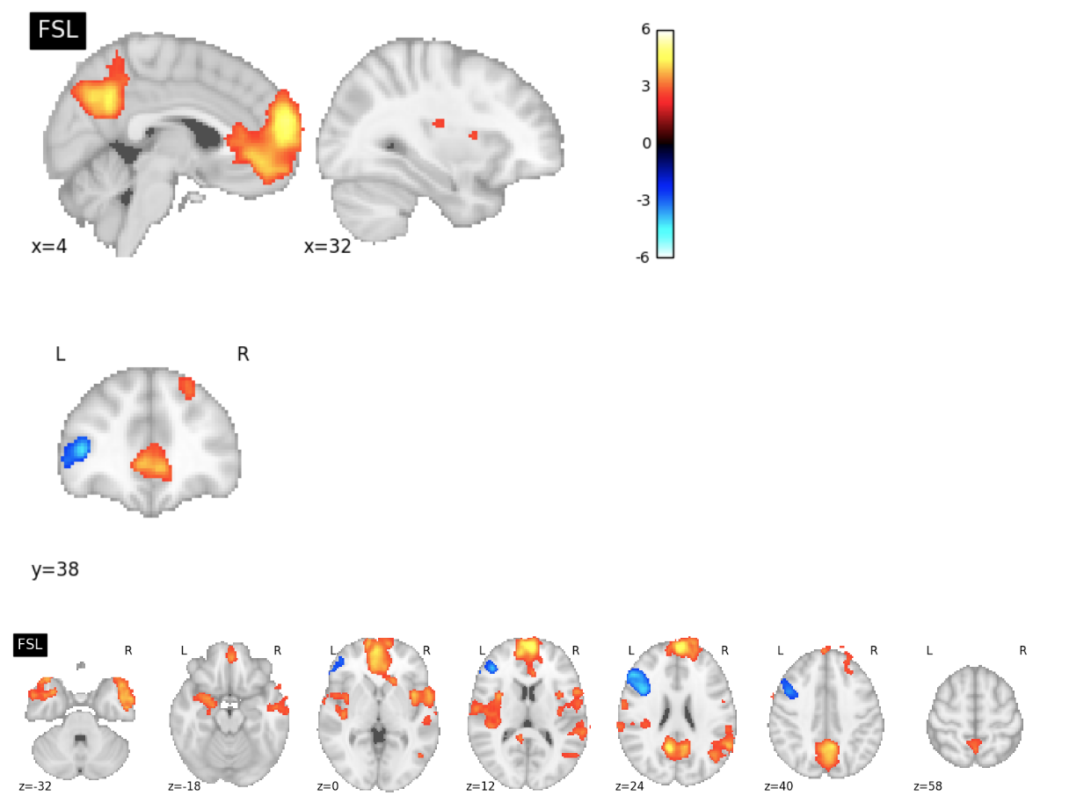
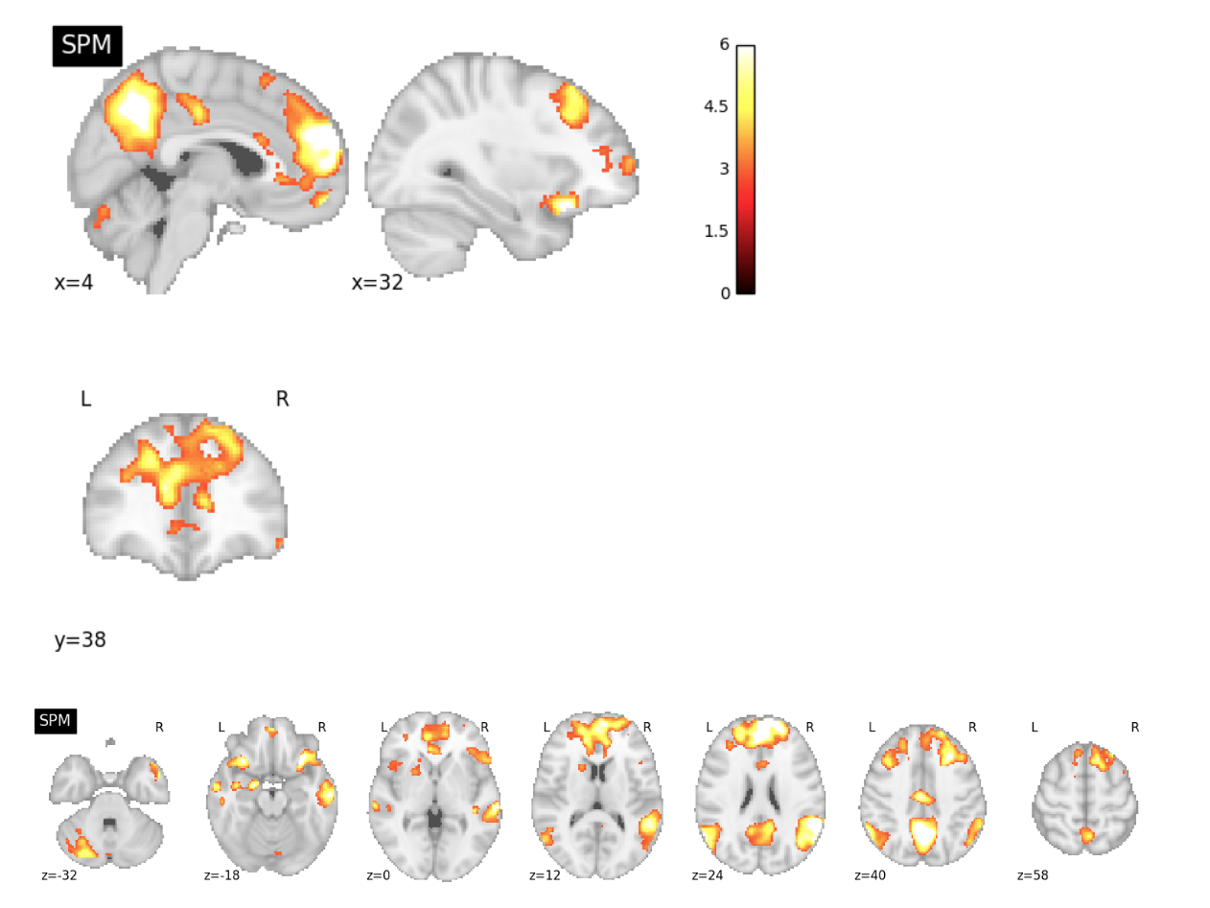
ds000109 Reproduction Excursion Set Map Slice Comparisons

Slide 4
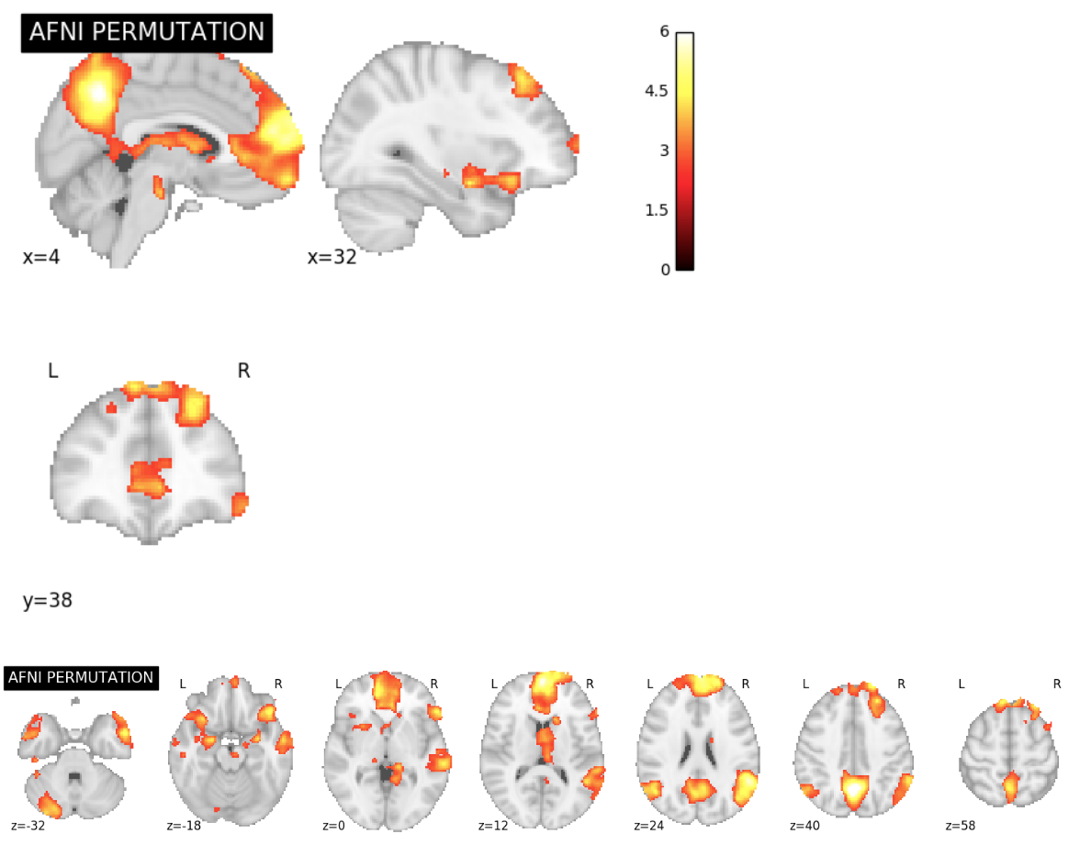
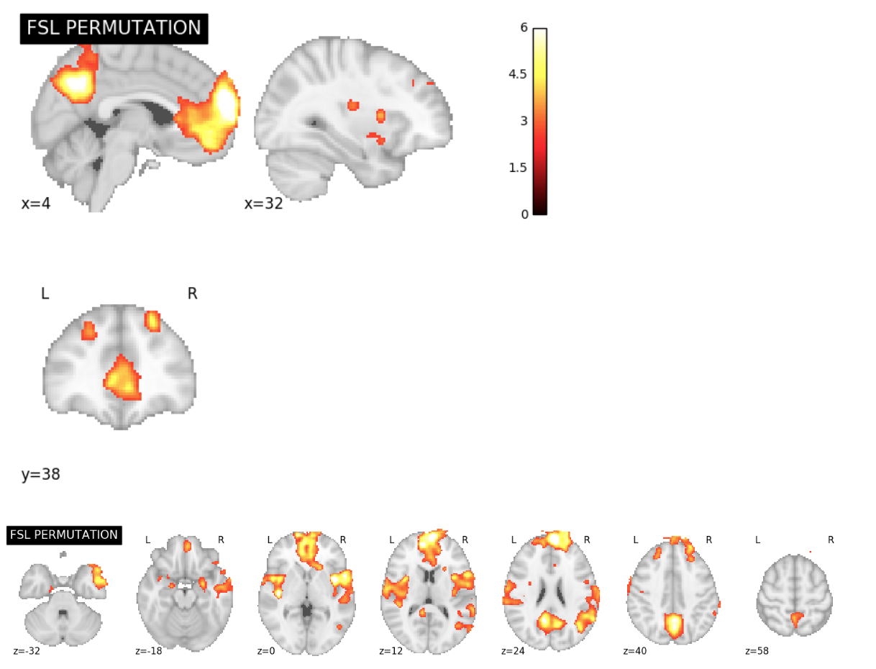
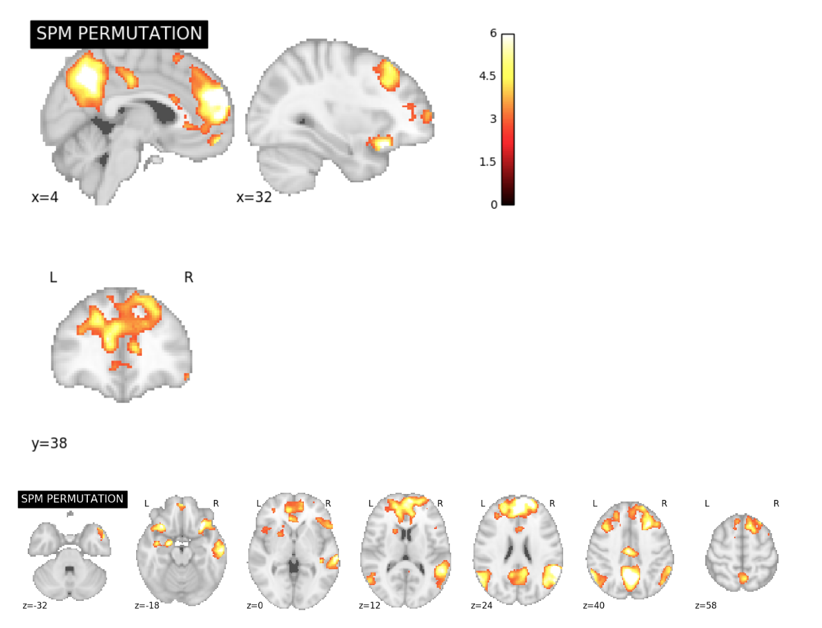
ds000109 Permutation Test Excursion Set Map Slice Comparisons

Slide 5
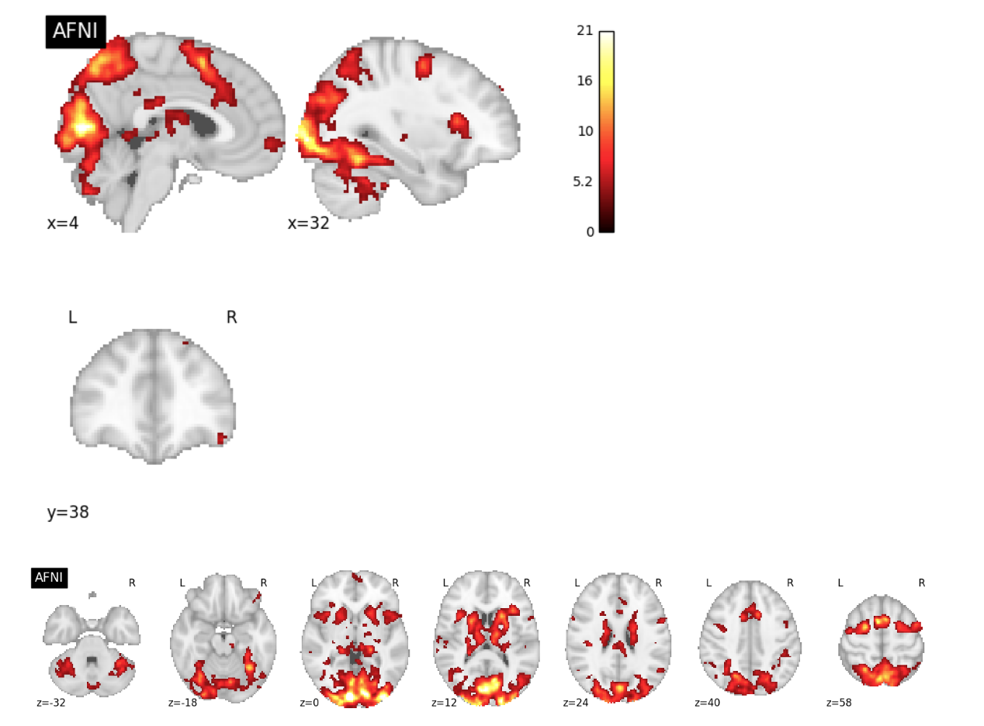
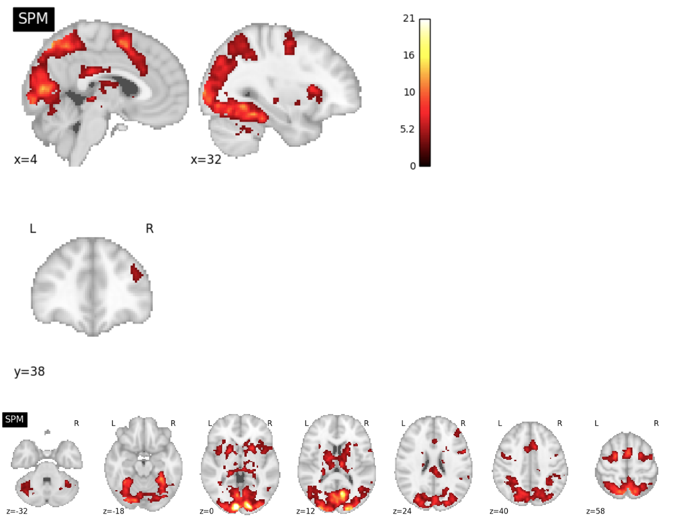
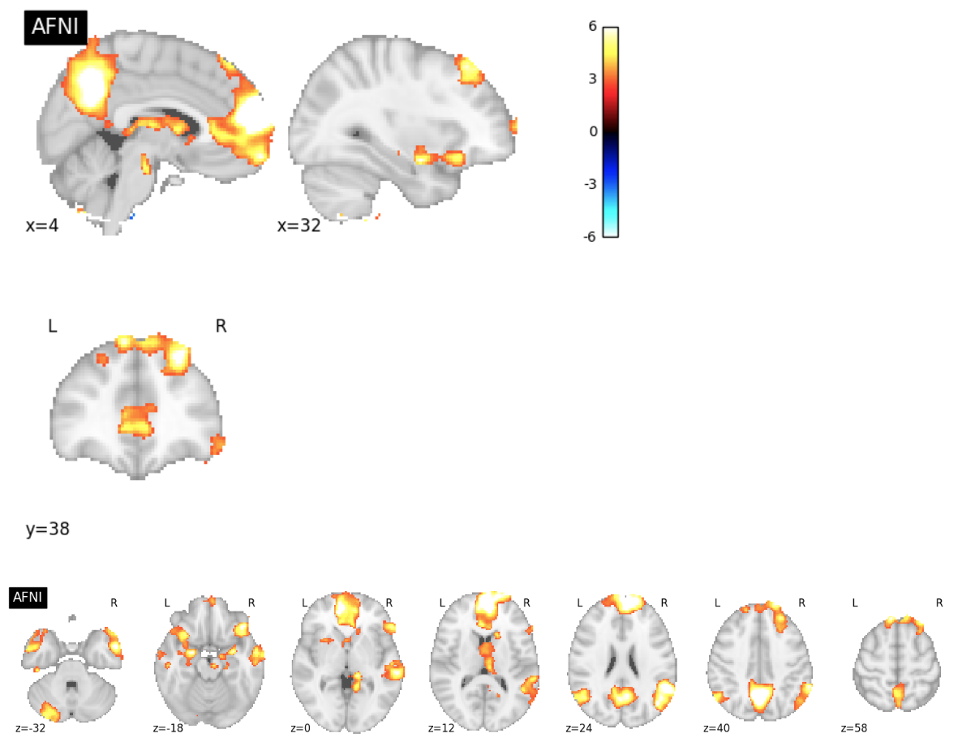
ds000120 Reproduction Excursion Set Map Slice Comparisons

Slide 6
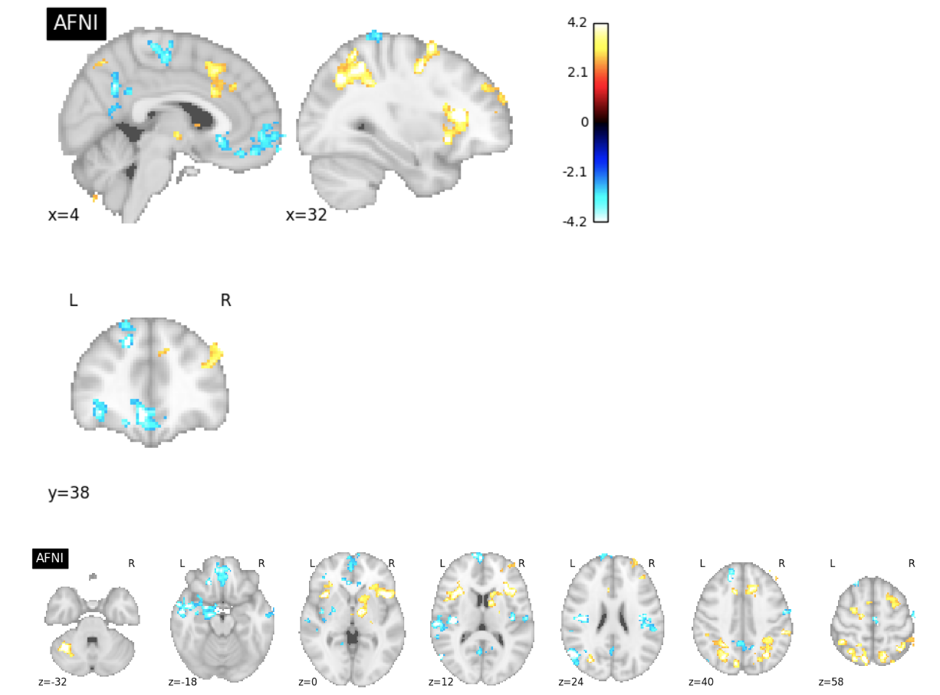
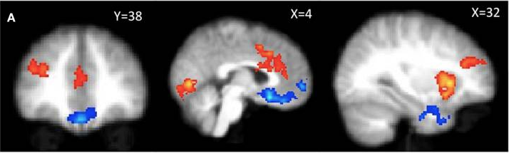
ds000001 Publication Figure Reproduction
PUBLICATION
4.2
-2.3
R L
2.3
-4.2

Slide 7
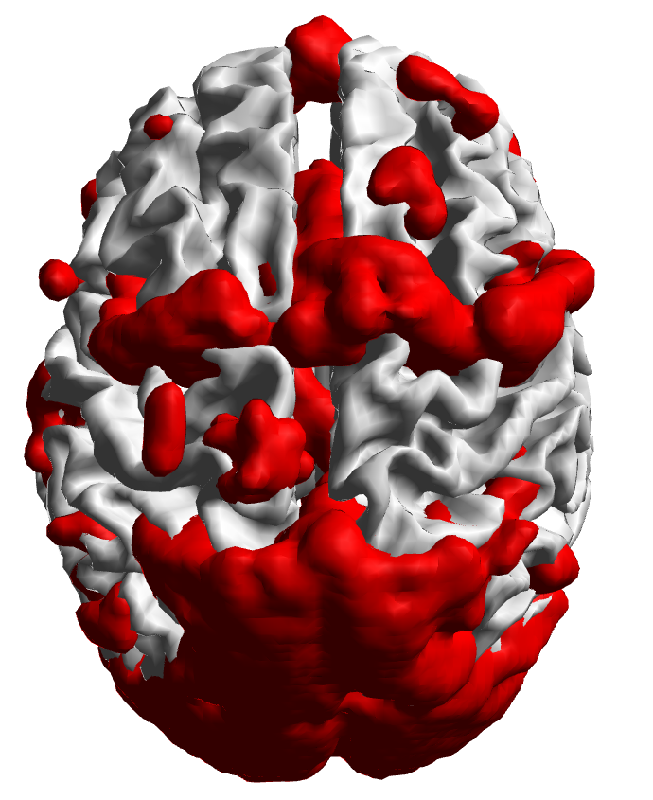
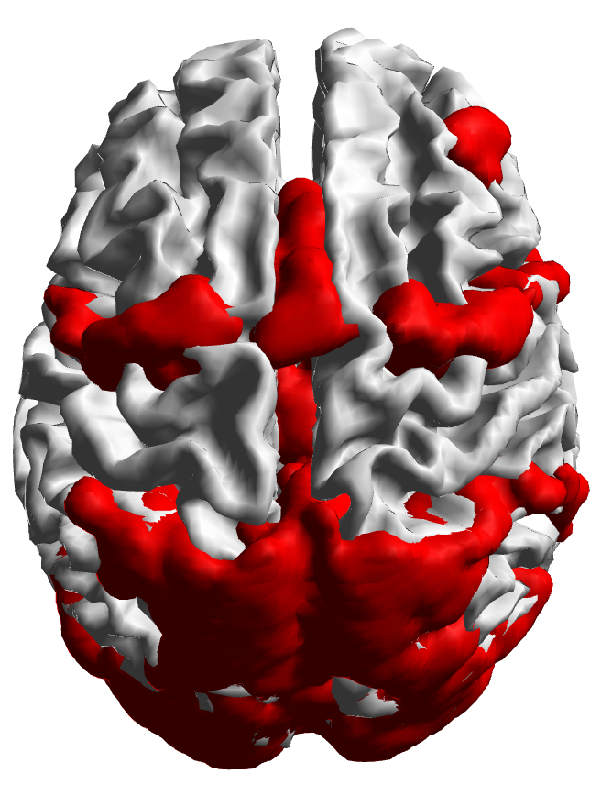
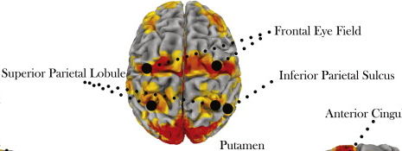
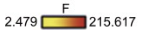
ds000120 Publication Figure Reproduction
PUBLICATION

Slide 8
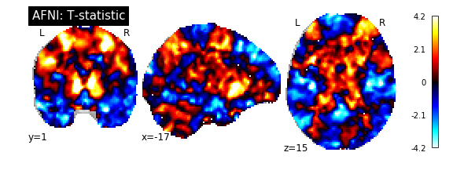
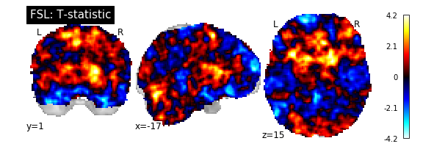
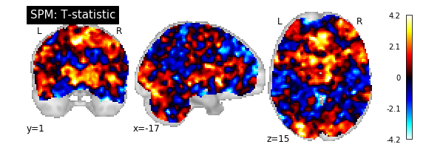
ds000001 Reproduction T-Statistic Map Slice Comparisons

Slide 9
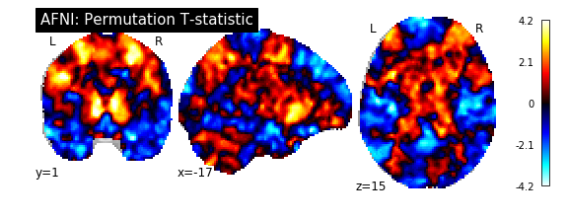
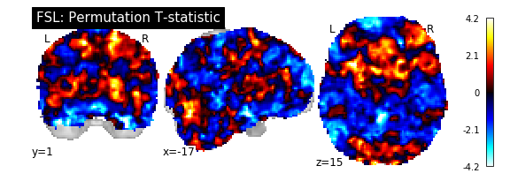
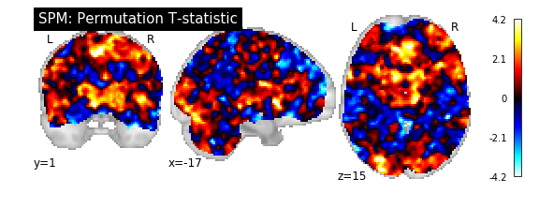
ds000001 Permutation Test T-Statistic Map Slice Comparisons

Slide 10
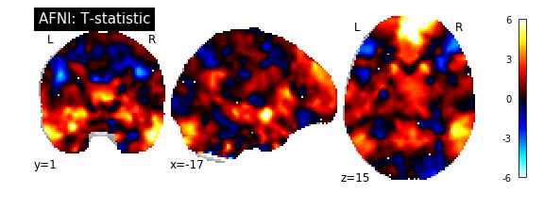
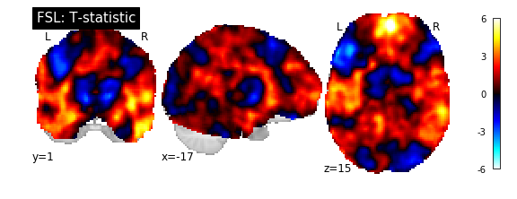
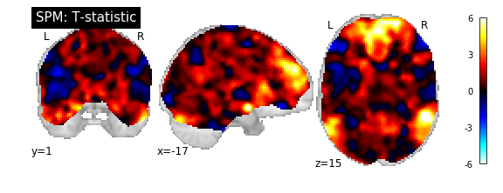
ds000109 Reproduction T-Statistic Map Slice Comparisons

Slide 11
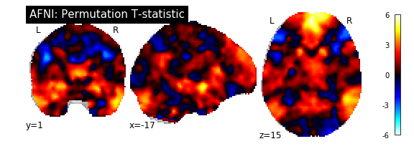
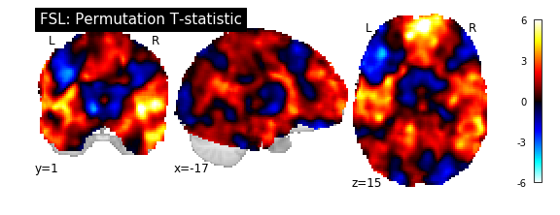
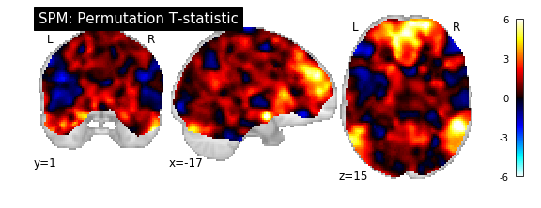
ds000109 Permutation Test T-Statistic Map Slice Comparisons

Slide 12
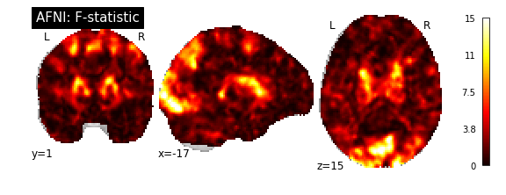
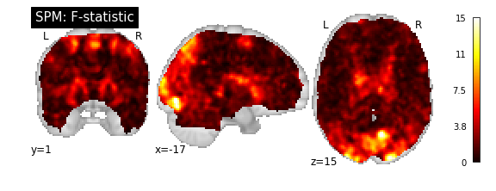
ds120 Reproduction F-Statistic Map Slice Comparisons

Slide 13
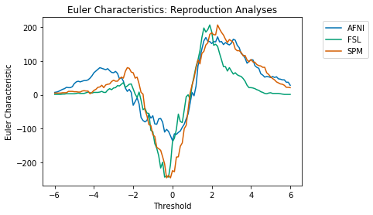
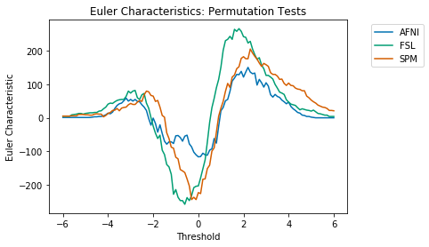
ds000001 Euler Characteristics

Slide 14
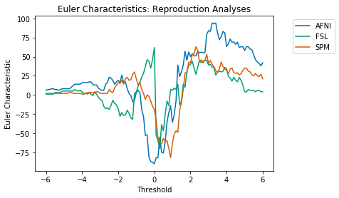
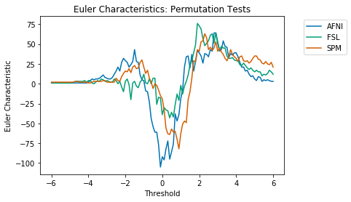
ds000109 Euler Characteristics

Slide 15
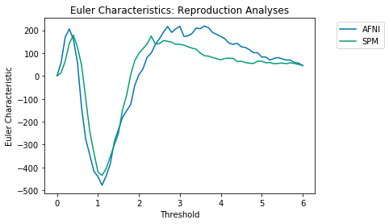
ds000120 Euler Characteristics

Slide 16

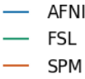
Euler Characteristics
ds000001
ds000109
Reproduction Analyses
Permutation Test Analyses

Slide 17
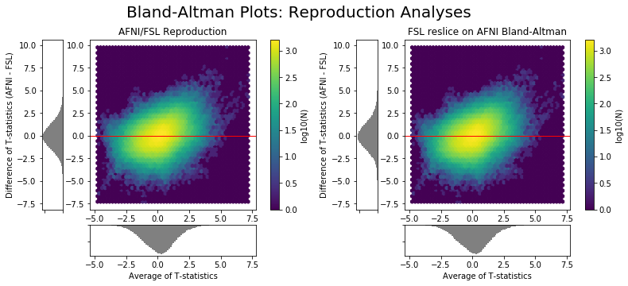
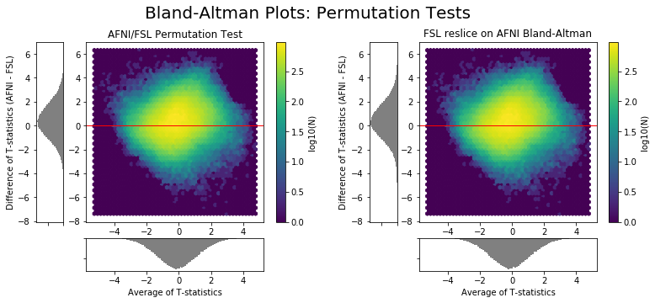
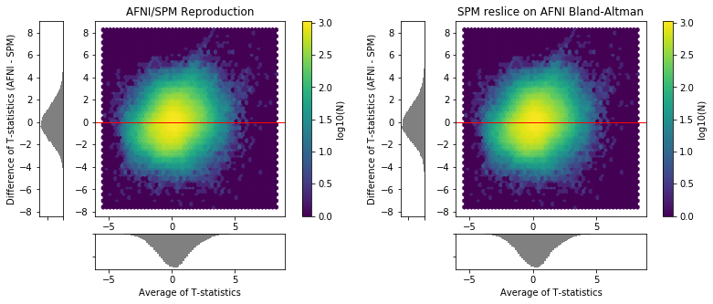



Bland-Altman Plots: ds000001
Reproduction Analyses
Permutation Tests

Slide 18






Bland-Altman Plots: ds000109
Reproduction Analyses
Permutation Tests

Slide 19
Bland-Altman Plots: Reproduction Analyses
ds000001
ds000109

Slide 20

Bland-Altman Plots: Reproduction Analyses
ds000120

Slide 21
Bland-Altman Plots: Permutation Tests
ds000001
ds000109

Slide 22




Bland-Altman Plots: Intra-Software Comparisons
ds001
ds109

Slide 23


ds000001 Dice Coefficients

Slide 24

ds000109 Dice Coefficients

Slide 25

ds000120 Dice Coefficients

Slide 26
Dice Coefficients
ds000001
ds000109
ds000120
Positive Activation Dice Coefficients
Negative Activation Dice Coefficients

Slide 27






Thresholded maps; parametric results
ds000001
ds000109
ds000120
4.2
-2.3
2.3
-4.2

Slide 28








Unthresholded maps; parametric results
ds000001
ds000109
ds000120

